Slide 1
NoC Performance Analysis Tool with Hybrid Arbitration

Slide 2
Agenda
Recap
Code Changes
Back Pressure Handling
Next Steps

Slide 3
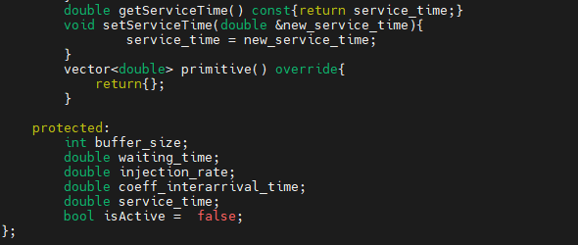
Updates to Class Queue
New Data Member
service_time : Represents the service time of each queue.
New Member Functions
getServiceTime() : To get the service time of each queue.
setServiceTime(double &new_service_time) : To set the service time of each queue.

Slide 4
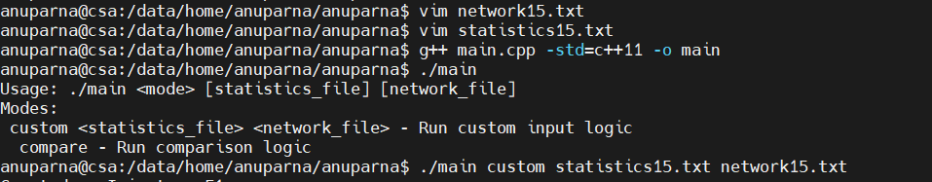
Updates
New added member in class Arbiter
zero_load_latency: Represents zero load of the arbiter.
getZeroLoadLatency(): Return zero_load_latency of the corresponding arbiter(RRarbiter, PRarbiter).
setZeroLoadLatency(): set zero_load_latency to the arbiter (RRarbiter, PRarbiter)
Passing Statistics_file and network file through terminal
Make statistics.txt file
Make network.txt file
./main custom statistics.txt network.txt

Slide 5
Agenda
Recap
Code Changes
Back Pressure Handling
Next Steps

Slide 6






Handling BackPressure
Forward Move
$T_{1}^{′}$ +$∆T_{1}^{′′}$
N1
Q1
N3
RR1
F1
$T_{2}^{′}$ +$∆T_{2}^{′′}$
Q2
SR1
Q3
PR1
F2
N5
N6
N8
SR2
SR3
N10
N11
N12
N13
N2
N4
Sink
$T_{1}^{′}$ +$∆T_{1}^{′}$
F3
Q5
N7
N9
$$T_{2}^{′}$$
$$T_{1}^{′}$$
Q4
$T_{2}^{′}$ +$∆T_{2}^{′}$
Backward Move

Slide 7
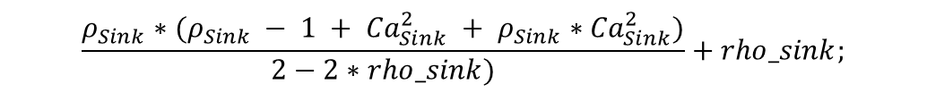
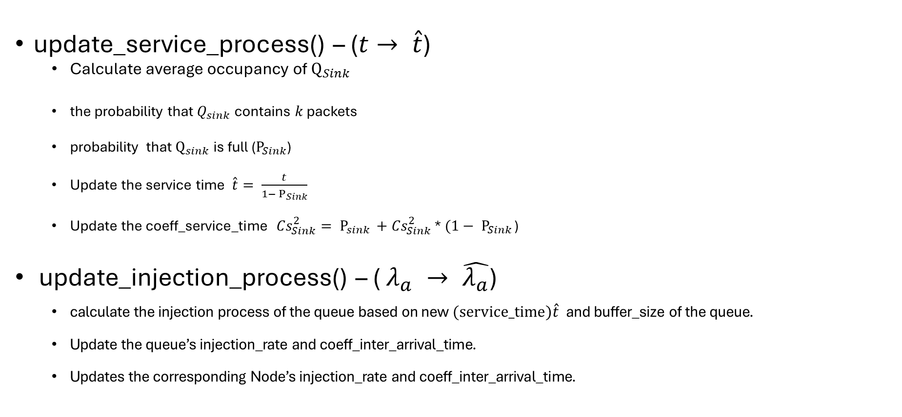
New added Functions()
update_service_process() – ($t→ \hat{t}$)
Calculate average occupancy of $Q_{Sink}$
the probability that $Q_{sink}$contains $k$ packets
probability that $Q_{sink}$is full ($P_{Sink}$)
Update the service time $\hat{t}= \frac{t}{1− P_{Sink}}$
Update the coeff_service_time ${Cs}_{Sink}^{2}= P_{sink }+{Cs}_{Sink}^{2}$ * $(1− P_{Sink }$)
update_injection_process() – ( $λ_{a} → \hat{λ_{a}}$)
calculate the injection process of the queue based on new $(service_time)\hat{t}$ and buffer_size of the queue.
Update the queue’s injection_rate and coeff_inter_arrival_time.
Updates the corresponding Node’s injection_rate and coeff_inter_arrival_time.
$$\frac{ρ_{Sink}∗(ρ_{Sink} − 1 + {Ca}_{Sink}^{2} + ρ_{Sink}∗{Ca}_{Sink}^{2})}{2−2∗rho_sink)}+rho_sink;$$

Slide 8
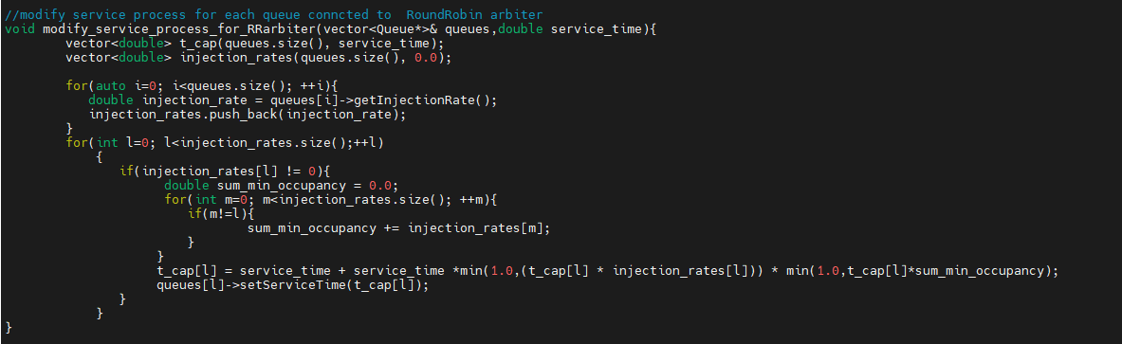
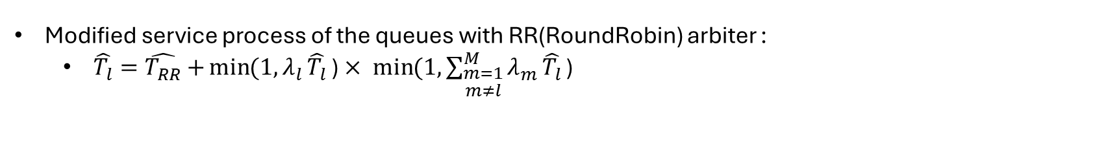
Modifying Service Process of the Queues with RR arbiter
Modified service process of the queues with RR(RoundRobin) arbiter :
$\hat{T_{l}}=\hat{T_{RR}}$ $+\min{(1, λ_{l}}\hat{T_{l}}$ ) $× \min{(1, \sum_{\begin{aligned}m=1 \\ m≠l\end{aligned}}^{M}{λ_{m}}}\hat{T_{l}}$ )

Slide 9
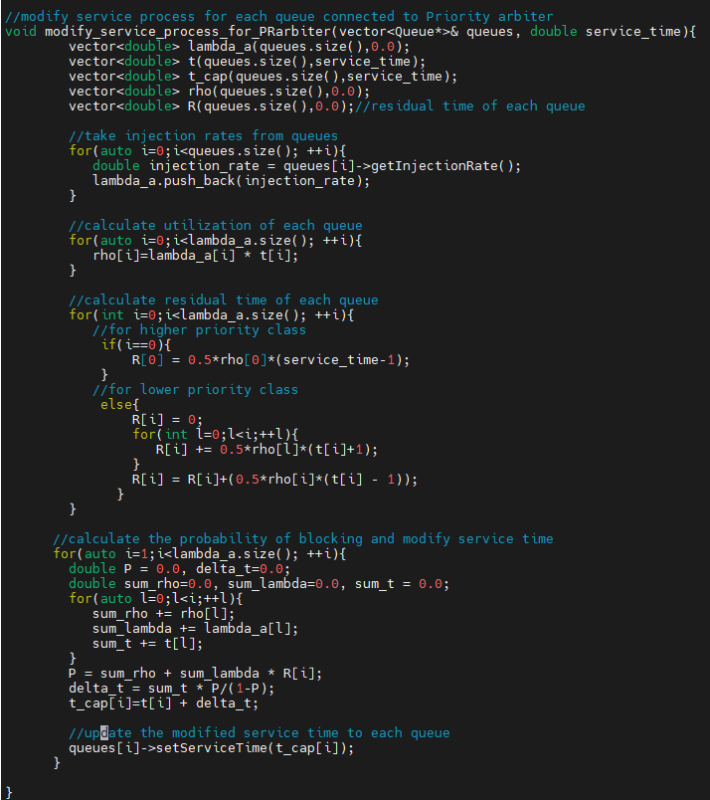
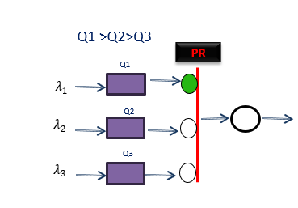
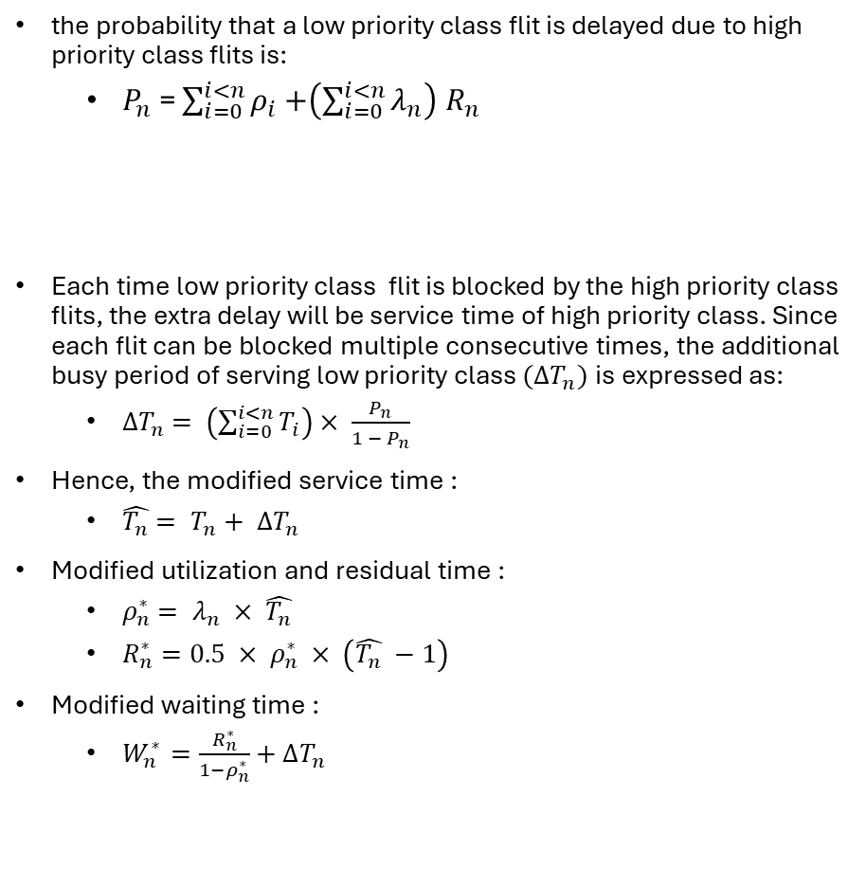
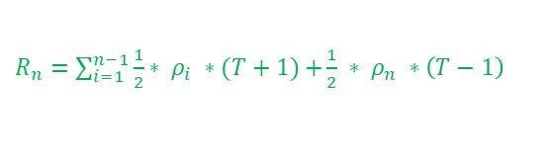

Modifying Service Process of the Queues with PR arbiter
the probability that a low priority class flit is delayed due to high priority class flits is:
$P_{n}$ = $\sum_{i=0}^{i<n}{ρ_{i}}$ $+\left(\sum_{i=0}^{i<n}{λ_{n}}\right)$ $R_{n}$
Each time low priority class flit is blocked by the high priority class flits, the extra delay will be service time of high priority class. Since each flit can be blocked multiple consecutive times, the additional busy period of serving low priority class $(ΔT_{n})$is expressed as:
${∆T}_{n}$ $= \left(\sum_{i=0}^{i<n}{T_{i}}\right)$ $× \frac{P_{n}}{1 − P_{n}}$
Hence, the modified service time :
$\hat{T_{n}}$ $= T_{n}+ {∆T}_{n}$
Modified utilization and residual time :
$ρ_{n}^{∗}$ $= λ_{n} × \hat{T_{n}}$
$R_{n}^{∗}=0.5 × ρ_{n}^{∗}$ $× \left(\hat{T_{n}} −1\right)$
Modified waiting time :
$W_{n}^{∗ }$ $=\frac{R_{n}^{∗}}{1−ρ_{n}^{∗}}$ $+ {∆T}_{n}$
$ρ_{n}$ $= λ_{n}$ $×t$
$R_{n}=\sum_{i=1}^{n−1}{\frac{1}{2}}$ $∗ ρ_{i} ∗(T+1)$ $+\frac{1}{2} ∗ ρ_{n} ∗\left(T−1\right)$

Slide 10
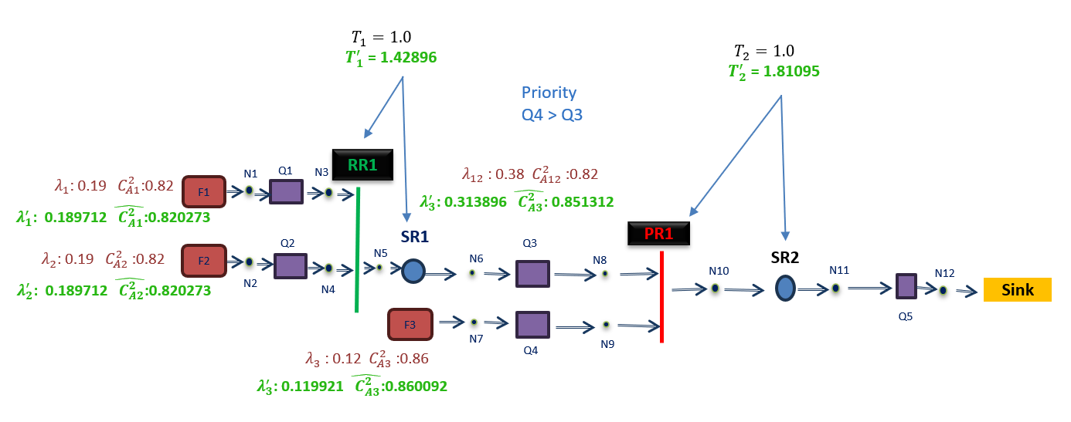
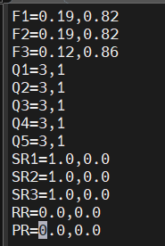
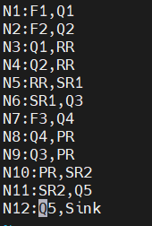

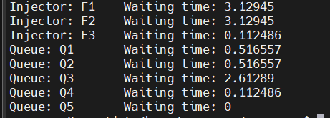

Continue…
Statistics.txt
Network.txt
Arbiter is Connnected to which nodes
Waiting Time After Handling Finite Buffer
Injector is iterated through which Queues

Slide 11
Next Steps
Equation verification and refinement:
Checking and adjusting equations to ensure accuracy

Slide 12
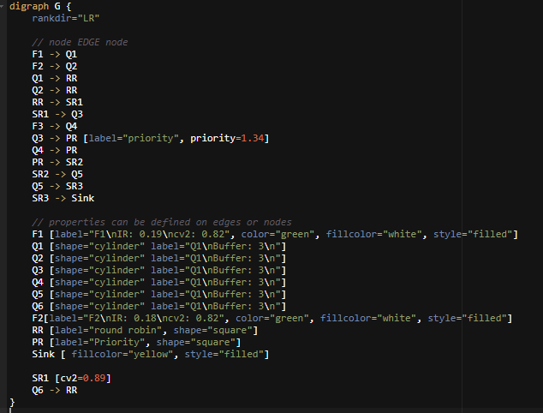
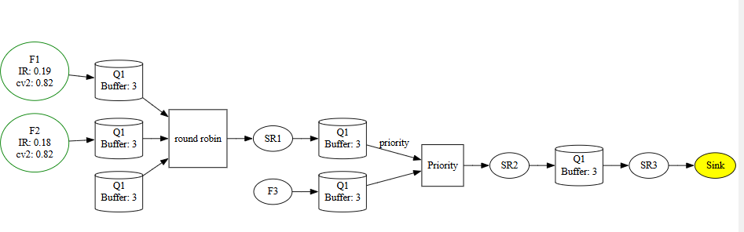
Our Goal
Output
Plan:
Integrating DoT language and Graphviz with our analytical model

